Slide 1
“global knowledge support service”: The story so far

Slide 2
Convergence and common understanding
Needs
Users: national governments +
Structure: based around the needs for implementation, monitoring, reporting, and review of the GBF
Resources: capacity building resources how to guides, helpdesk, support for national monitoring systems, case studies
Role in convening and facilitating access to networks

Slide 3
Convergence and common understanding
Federated to regional level
Feasibility and collaborative are key considerations

Slide 4
Support for national processes
National review of progress (8NR)
National planning
National reports and use of indicators
National reports and use of indicators
National review of progress (7NR)
IMPLEMENTATION
NBSAPs and use of indicators
COP16
2024
COP17
2026
COP19
2030

Slide 5
ENABLERS/ ELEMENTS | People & Culture | Partnerships | Data governance | Technology transfer | Training/ learning | Knowledge management
Global biodiversity framework (monitoring, indicators, data quality & availability)
Thematic insights for policy and planning
Support to national systems (SEEA/DaRT)
Private sector uptake and decision support
Standardisation and interoperability

Slide 6
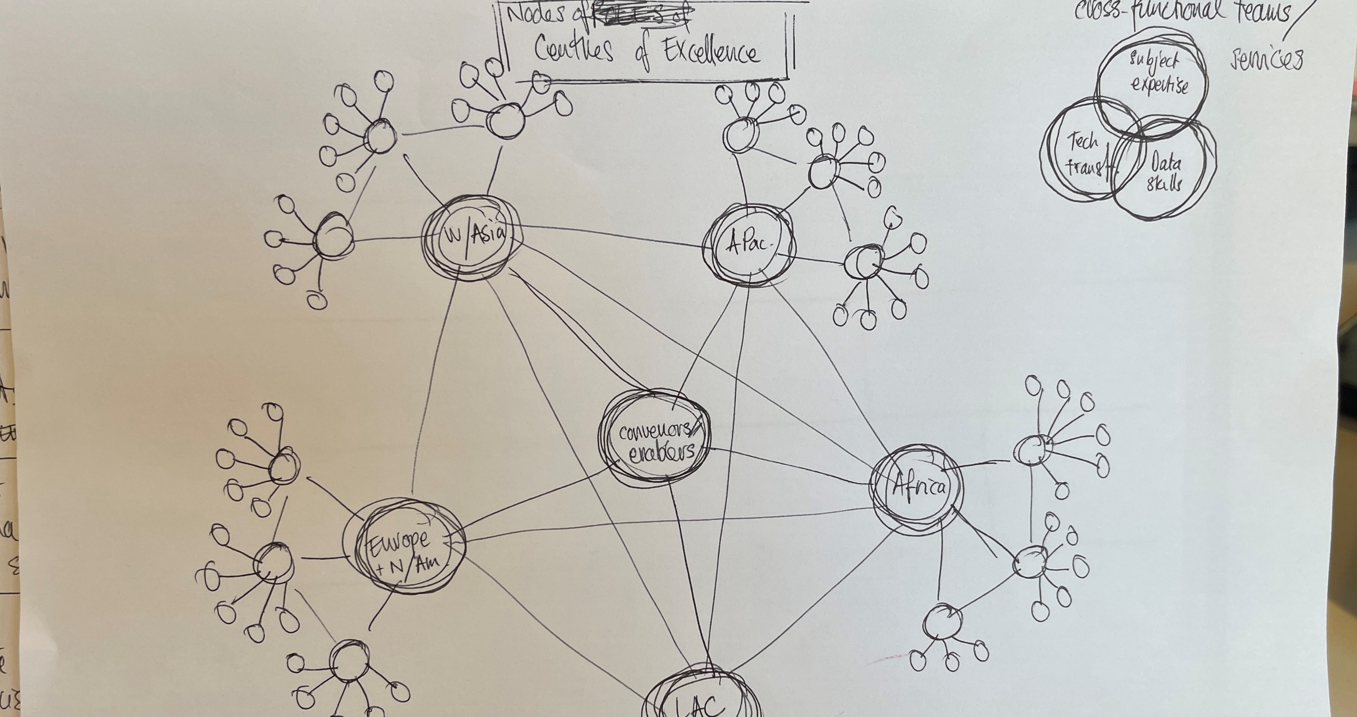

Slide 7
Support for national processes
COP16
2024
COP17
2026
COP19
2030
National review of progress (8NR)
National review of progress (7NR)
National planning; revision of NBSAPs, indicators
IMPLEMENTATION
Indicator support
Thematic insights
Private sector uptake
Standardisation and interoperability
National information systems

Slide 8
FOLLOW UP DISCUSSIONS
Governance options
Functionality in relation to the processes adopted, and how users will access the resources
Interoperability with existing systems
Funding
Regional dialogues on all of the above

