Slide 1
GEO’s experience in data management and governance
Madeeha Bajwa, GEO Secretariat

Slide 2
Data with principles
FAIR Principles – 2016 – Findability, Accessibility, Interoperability, and Reusability
CARE Principles for Indigenous Data Governance – 2020
TRUST Principles – 2020 – Transparency, Responsibility, User focus, Sustainability, and Technology
UNESCO’s Recommendation on Open Science – 2021
Notes:
Over the last years, we have been seeing an accelerated movement towards more open, transparent, and responsible approaches to data sharing and management. And the adoption of data principles has been a big part of that.
FP have been widely adopted to help make data findable, accessible, interoperable, and reusable for both humans and machines. These principles aim to enhance the reuse of data and support the development of new knowledge from existing data.
CARE Principles: introduced in 2020 were developed through a collaborative and inclusive process that involved input from indigenous communities, researchers, and other stakeholders from around the world.
TRUST Principles were designed to provide a framework for assessing and promoting the trustworthiness of data repositories and were informed by existing standards and best practices in data management and preservation. The TRUST principles are relatively new and have not yet been widely adopted.
These principles are aligned principles with UNESCO's Recommendation on Open Science to member states to adopt open science policies and practices

Slide 3
Resources
GEO Data Sharing and Management Principles (DMPs)
GEO DMPs Implementation Guidelines
GEO DMPs self-assessment tool
GEO DMPs online seminar recordings
Open Knowledge Statement, endorsed by GEO’s 114 members (EC + 113 countries).

Slide 4
Resources
Technical interoperability
GEO DAB is an open-source tool (https://github.com/ESSI-Lab/DAB)
Connected to most geospatial data platforms that use standards (GBIF is connected!) (see list: https://www.geodab.net/ - scroll down)
Legal interoperability
Data Licensing Guidance, 2023

Slide 5
Programmes
GEO GLAM
Standard methods for monitoring agricultural production
GFOI
Protocols for measuring changes in forest cover – REDD+
GEO LDN
Defined minimum standards for data quality for countries – 15.3.1
Promoting the Trends.Earth platform as a common tool, countries can access global datasets, or insert their own.

Slide 6
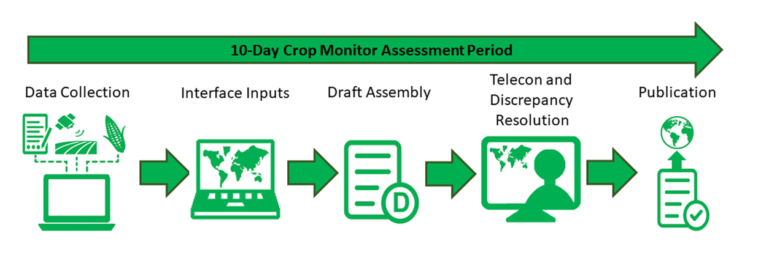
Programmes: GEO GLAM
Governance of the data: Every agency keeps ownership of the data they produce but the cooperation allows to produce a high quality, transparent, trusted and “neutral” product.

Slide 7
Collaborations
2019
17 COUNTRIES
$1.5m + $1m cap dev
2020
32 COUNTRIES
$3m + $1.5m cap dev
2021
18 COUNTRIES
$3m (50% cash)
+$1m cap dev

Slide 8
Open Data and Open Knowledge Workshop, 15-16 June 2023
Reflections
Bridging the gap between “research oriented” data and “operationally oriented” data
Diversity of data sources make developing common standards complex and time-consuming.
Flexibility in common standards and protocols.
Governance structures need to be established.
Widespread adoption and implementation of the standards and protocols - political levers.

