Slide 1
Data From the GBIF Network 31 March 2023

Slide 2
GBIF Participant countries 31 March 2023
Voting Participants
Associate Participants
Notes:
This map is fully editable. This map is a grouped element of all the countries in the world. All the countries are named correctly and can be accessed and selected via the Selection Pane.
There are ways you can edit and make changes to the map. But please remember to always make a copy of the map on your slide and never make changes to the toolkit version.
Please take a look at the next few slides to find out different ways of editing this map

Slide 3
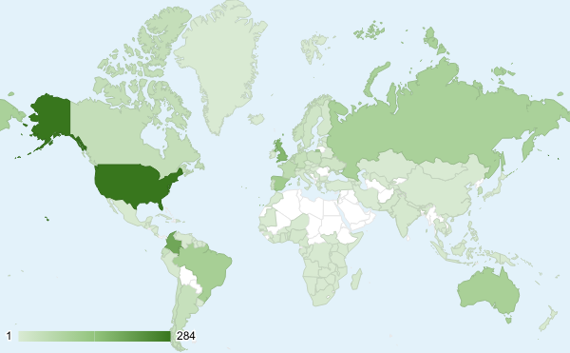
GBIF Network of Data publishing institutions 31 March 2023
135
countries/areas with institutions sharing data through GBIF
Top 10 countries: number of data publishers
1 | United States | 284
2 | Colombia | 197
3 | United Kingdom | 164
4 | Spain | 115
5 | Brazil | 103
6 | Australia | 99
7 | Russian Federation | 95
8 | France | 56
9 | Canada | 44
10 | Netherlands | 41

Slide 4
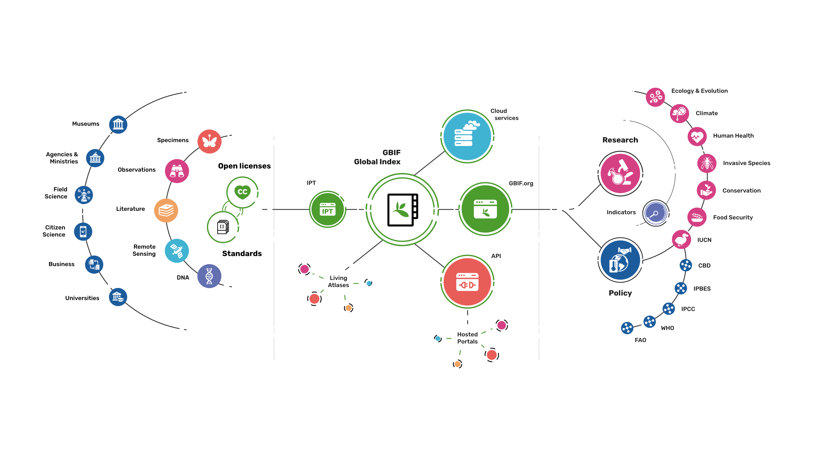
Providing biodiversity Evidence for research and policy

Slide 5
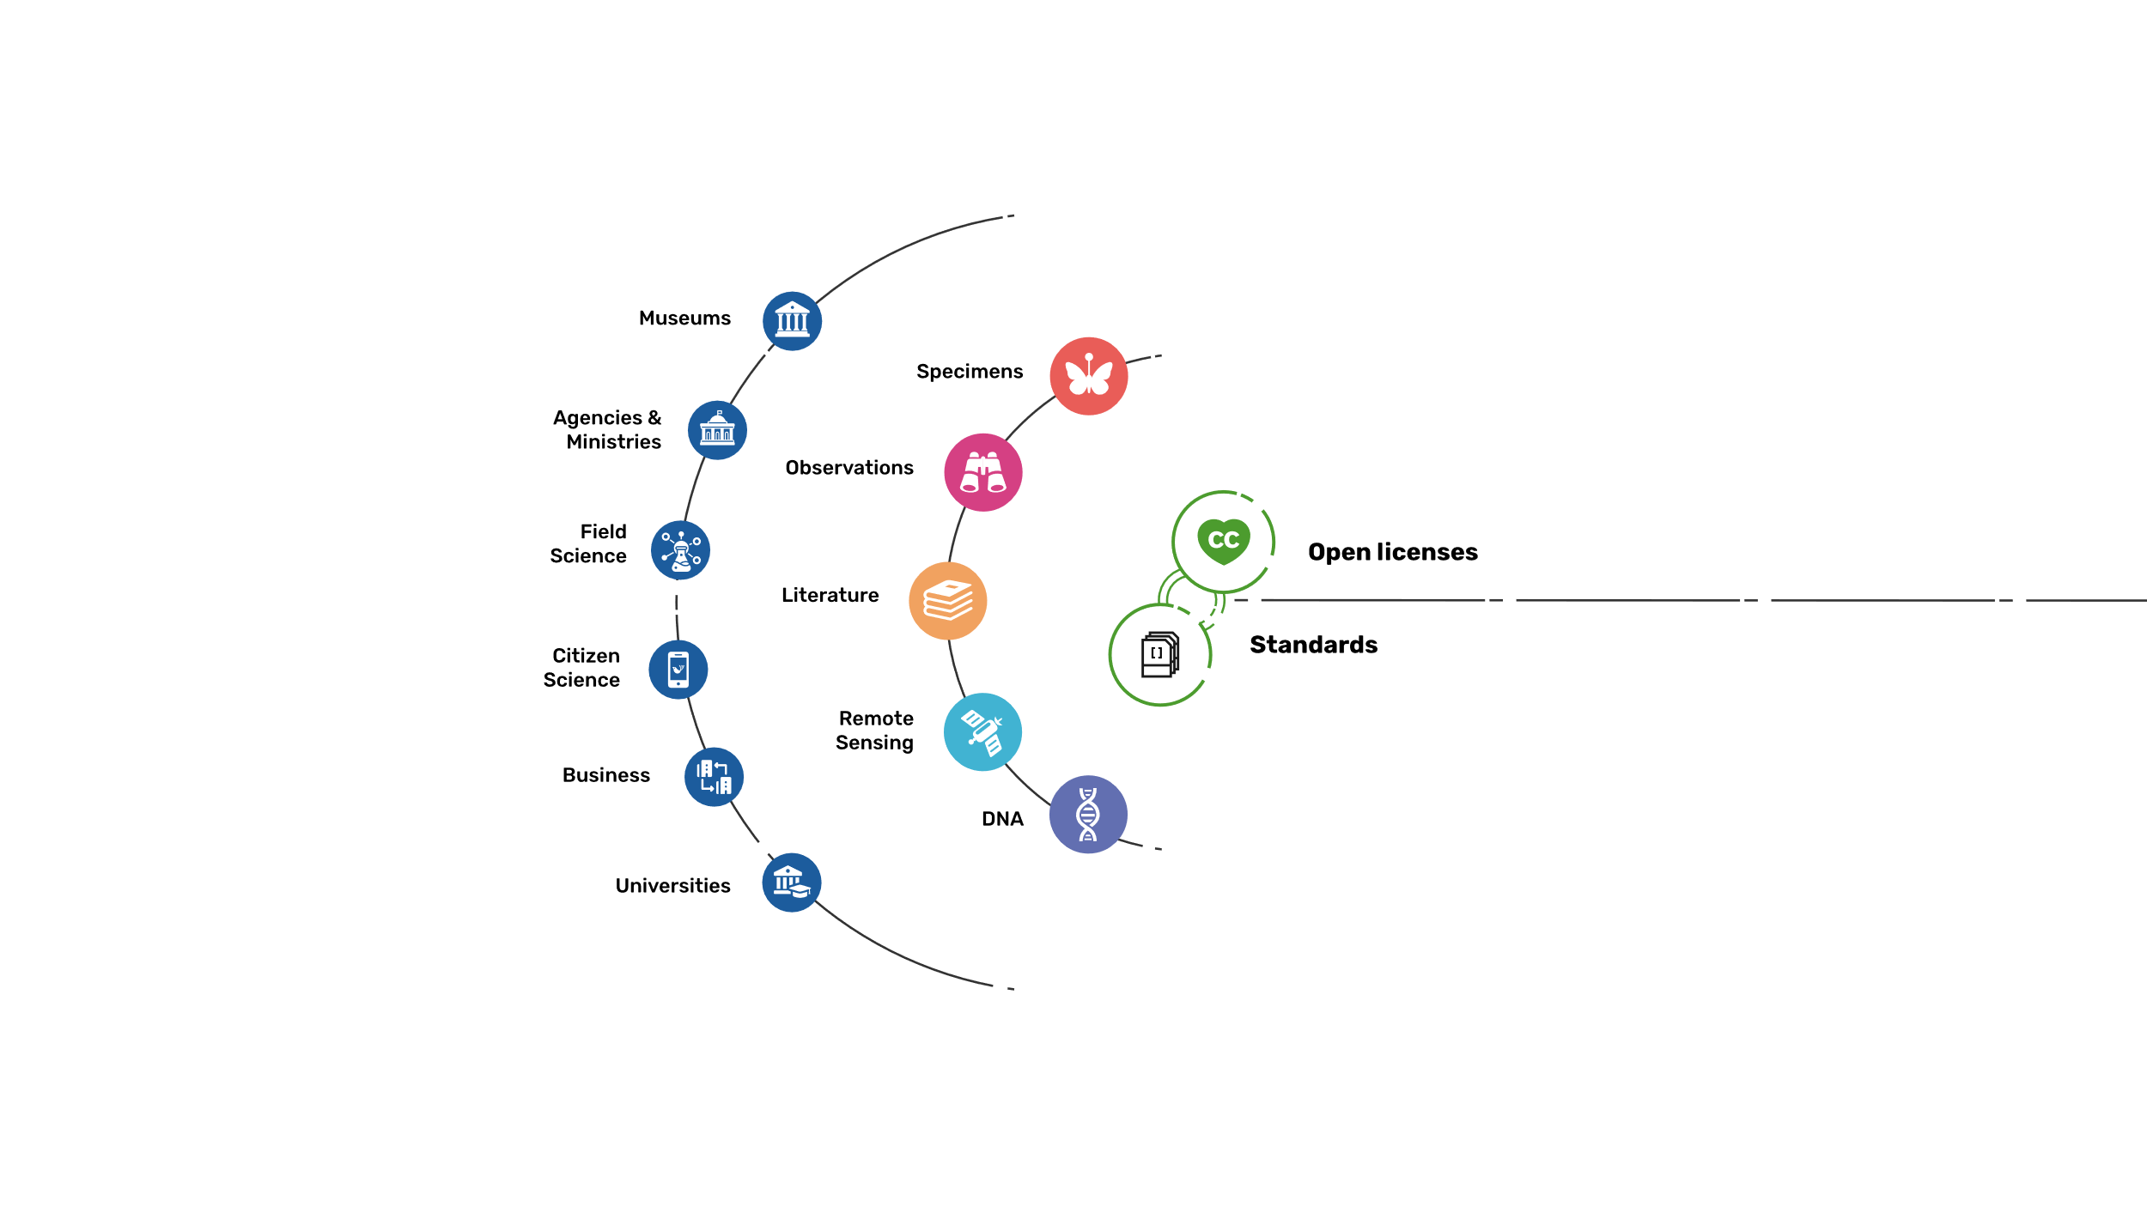
Sources of Biodiversity evidence
Create
Combine sources of evidence

Slide 6
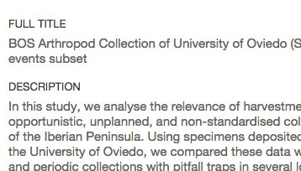
Data richness levels supported by Gbif
Dataset description, taxonomic/geographic/temporal scope, methodology
List of taxa based on geography, theme (e.g. invasive, medicinal)
01
02
Dataset metadata
Species checklists
Species occurrences, dates and coordinates
Occurrences with dates, coordinates, sampling protocol/effort, abundance
03
04
Occurrence-only data
Sampling-event data
Notes:
Frequently used slide, redone
Please copy and paste these to your slides and never make any changes to them directly in the toolkit.

Slide 7
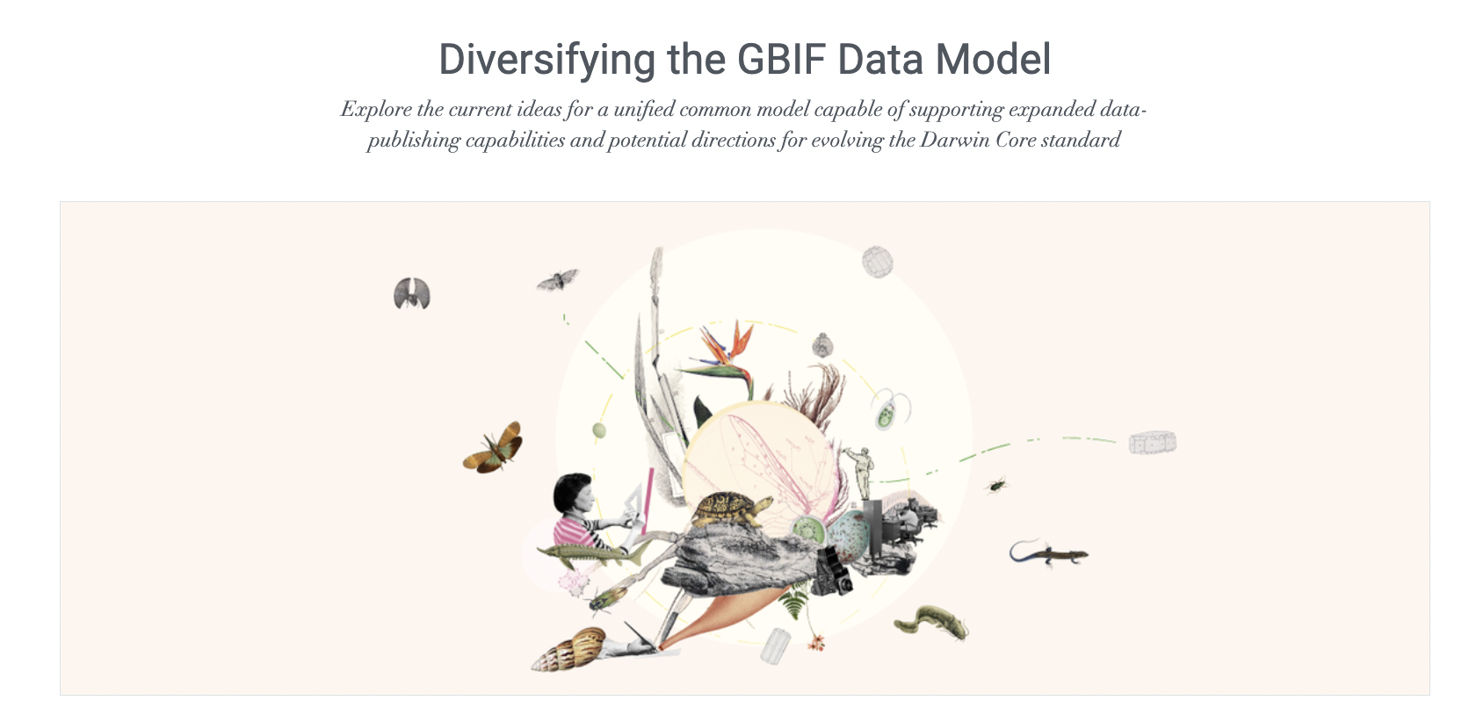
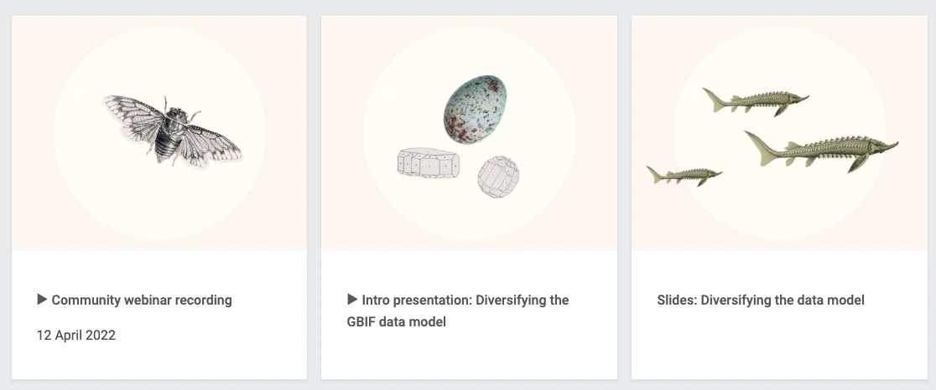
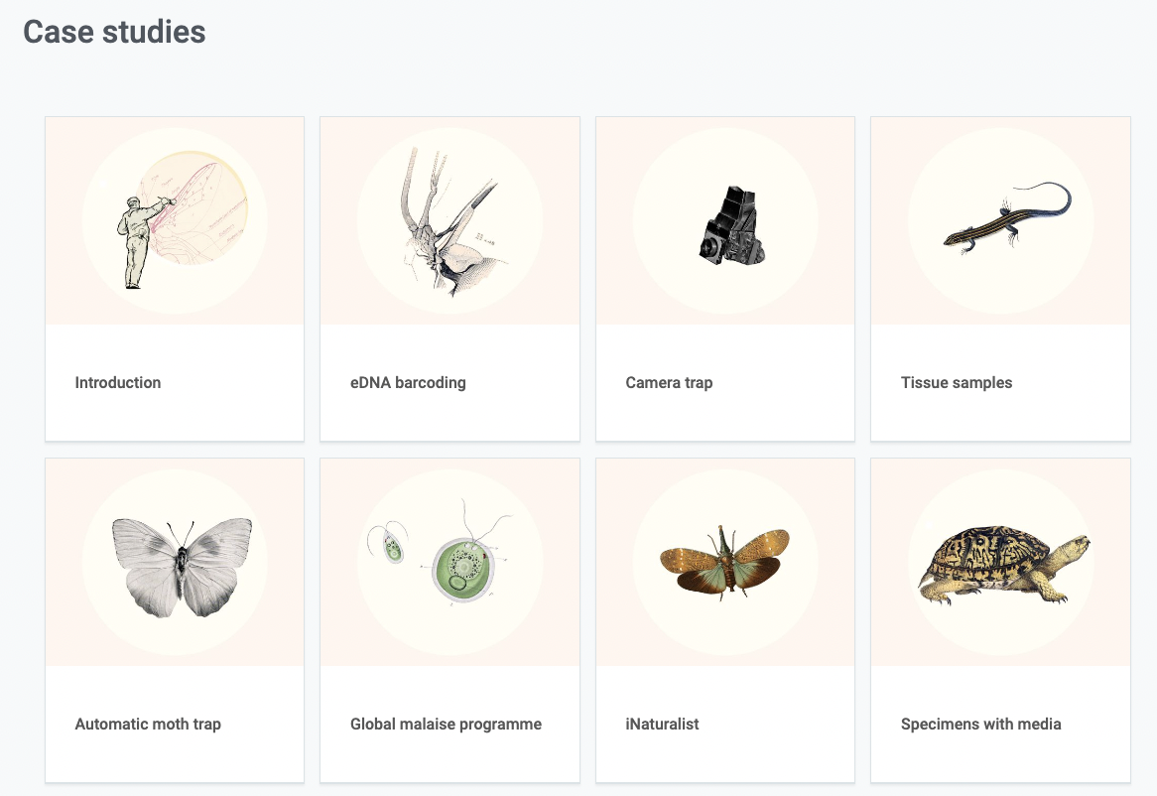
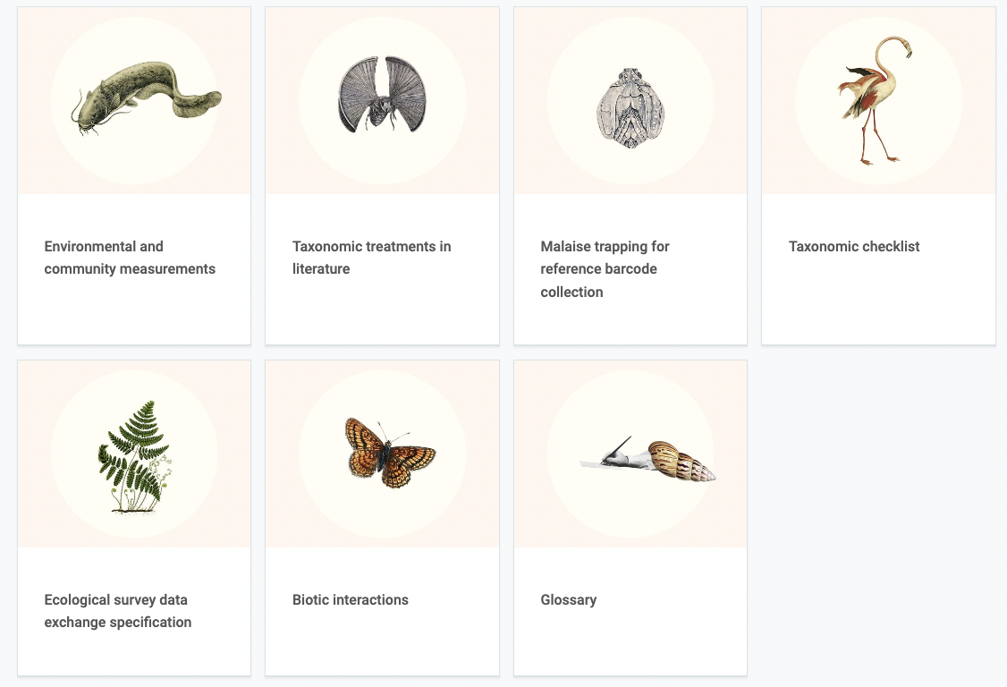
https://www.gbif.org/composition/HjlTr705BctcnaZkcjRJq/data-model

Slide 8
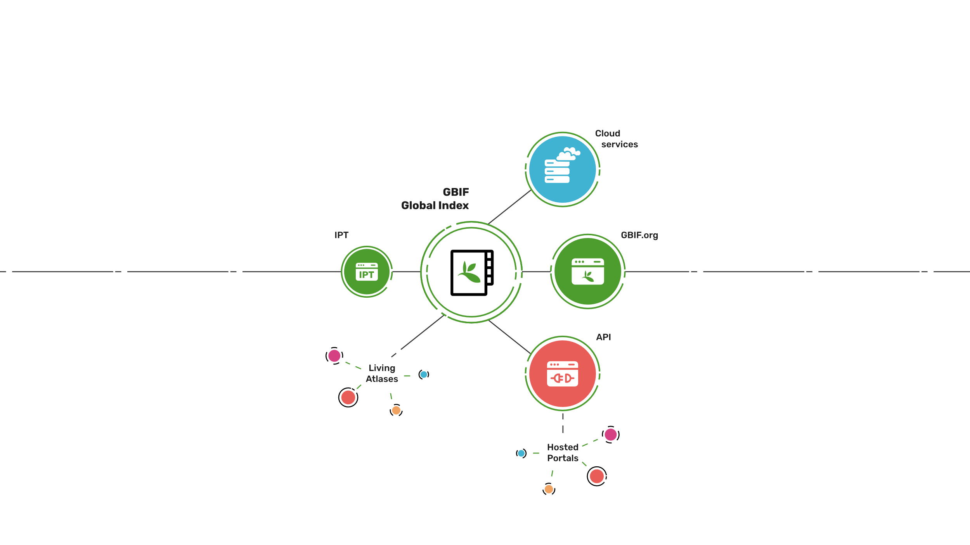
Access to biodiversity evidence
Share
FAIR and open access

Slide 9
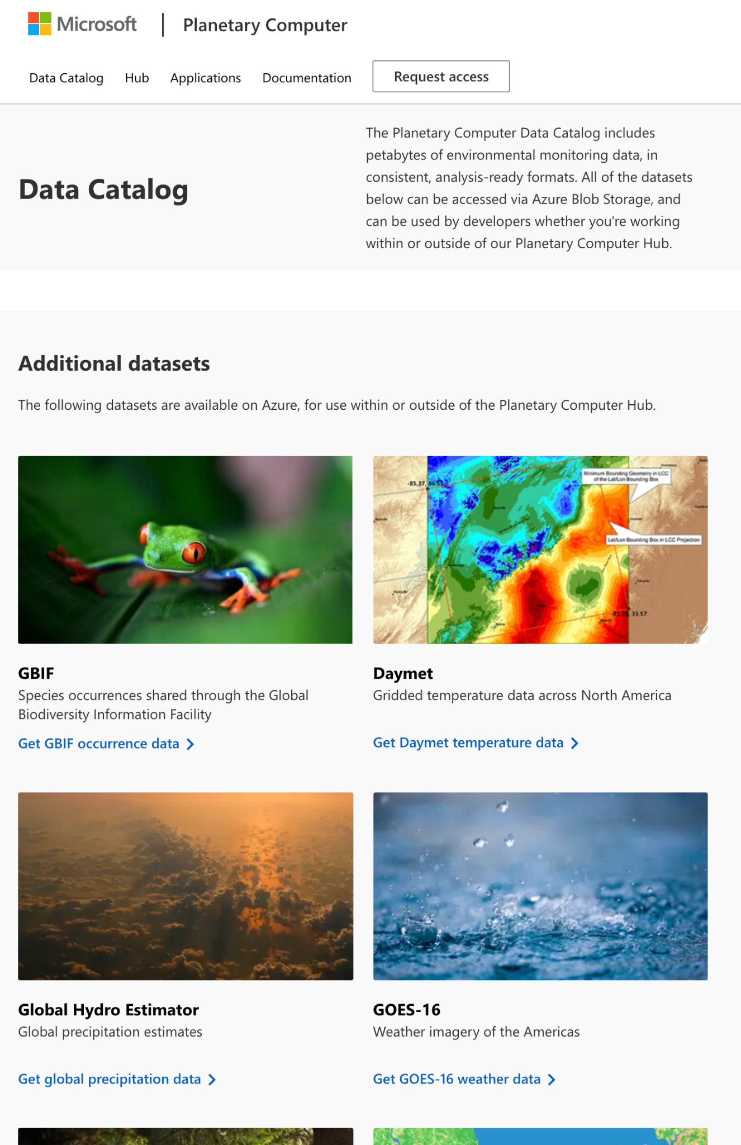
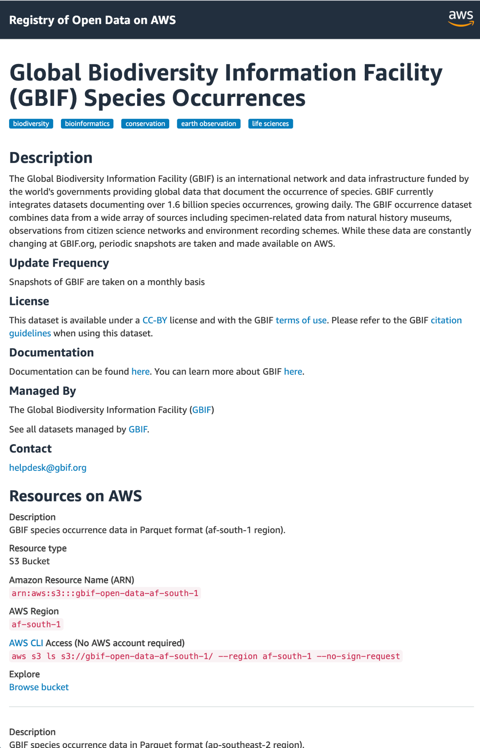

Slide 10
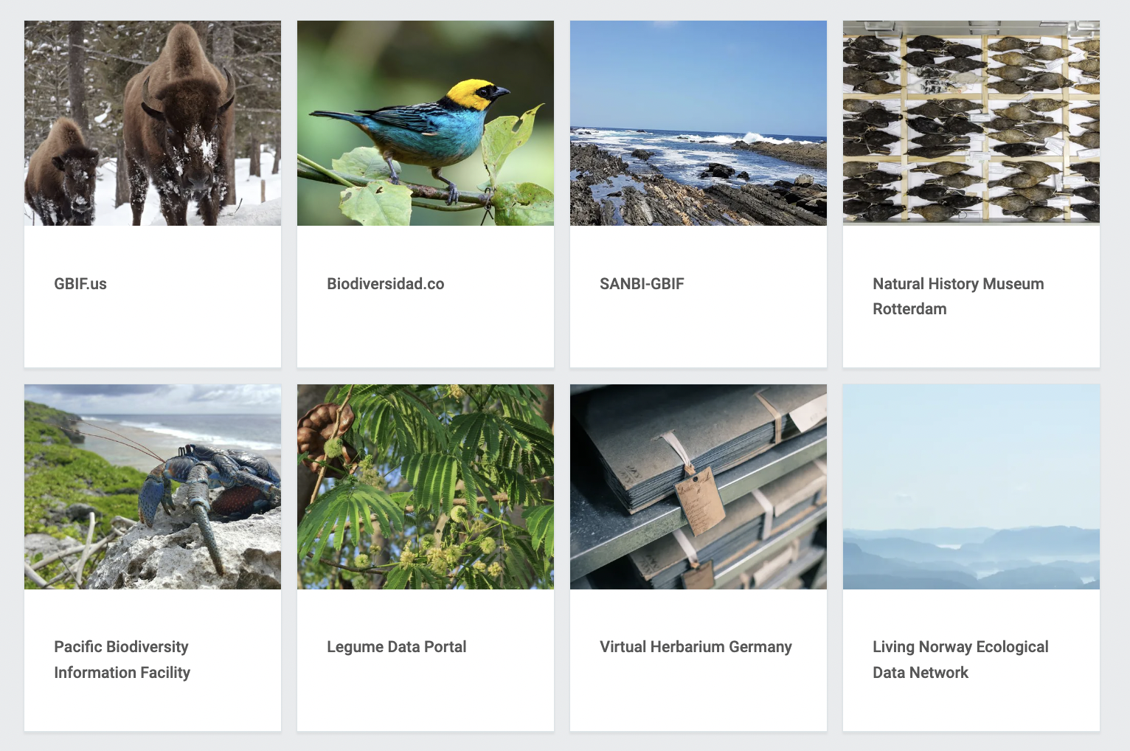
Hosted portals building on subsets of data shared through GBIF
https://www.gbif.org/hosted-portals

Slide 11
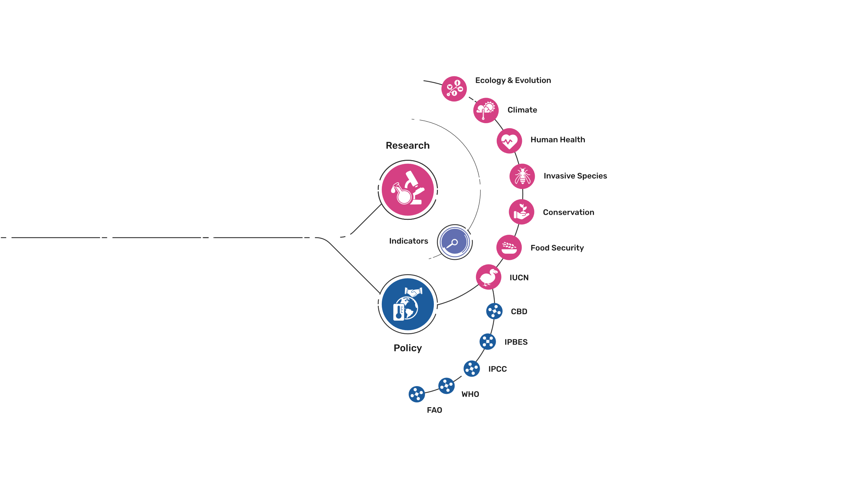
Uses of biodiversity evidence
Transform
Apply and use data

Slide 12
Peer-reviewed publications using GBIF-mediated data 31 March 2023
Notes:
The next 3 slides are showcasing PPT standard or Live charts.
To create a chart simply click on the Insert tap on the ribbon > Click on Chart > chose a chart of your choice (in this example I chose, Bar) > add in your data in the automatically opened Excel sheet and see your chart changing and adopting to the new information you have entered in the data sheet.

Slide 13
Thank you
Dr Andrew Rodrigues
arodrigues@gbif.org

